Slide 1
Installation Steps For Oracle DB
* Prerequisites : -
1. Hardware requirment : -
Min 8 GB RAM
8 or 16 GB swap
Min 80GB storage
Network connected
2. Software requirement : -
Linux OS – any oracle version (recommended), redhat 7 or 8
Pre installation RPM for your Linux release to configure your operating system for Oracle Database and Oracle Grid Infrastructure installations.

Slide 2
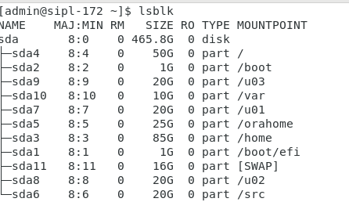
Partition Structure

Slide 3
Preinstallation for RPM
* When installed, the Oracle Database Preinstallation RPM does the following:
1. Automatically downloads and installs any additional RPM packages needed for installing Oracle Grid Infrastructure and Oracle Database, and resolves any dependencies
2.Creates an oracle user, and creates the oraInventory (oinstall) and OSDBA (dba) groups for that user
3. As needed, sets sysctl.conf settings, system startup parameters, and driver parameters to values based on recommendations from the Oracle Database Preinstallation RPM program
4.Sets hard and soft resource limits
5.Sets other recommended parameters, depending on your kernel version
6.Sets numa=off in the kernel for Linux x86_64 and Linux aarch64 machines.
****Note:
Configure Oracle Database preinstallation RPM only once on your operating system when you install Oracle Database or Oracle Grid Infrastructure for the first time on your system. For subsequent installations on the same system, do not install Oracle Database Preinstallation RPM again.

Slide 4
Preinstallation for Oracle Linux
1. Change the hostname #hostnamectl set-hostname sipl-ip #yum update -y #yum upgrade -y
2. install all the dependencies
#]yum install -y oracle-database-preinstall-19c
Or
install latest versions for following packages :
bc binutils compat-openssl11,elfutils-libelf fontconfig glibc glibc-devel ksh libaio libasan
Liblsan libX11 libXau libXi libXrender libXtst libxcrypt-compat libgcc
libibverbs libnsl
librdmacm
libstdc++
libxcb
libvirt-libs
make
policycoreutils
policycoreutils-python-utils
smartmontools
sysstat

Slide 5
Check wheather oracle user is created or not and its related groups:oinstall,dba,oper,backupdba,dgdba,kmdba,racdba
Note that : if you install dependent packages manually then you have to create oracle user and related groups and add that user in related groups. And also set kernel parameters manually in sysctl.conf (All this is done automatically when you are using Oracle linux os)
Create directory structure : for ORACLE_HOME, ORACLE_BASE and oracleInventory
Set path permenantly for ORACLE_HOME, ORACLE_BASE in user oracle.
If you are using x emulation then set then Log into the oracle user. set the DISPLAY environmental variable.
Extract the linux-oracle-database.zip file into $ORACLE_HOME (download from official site manually)
https://www.oracle.com/in/database/technologies/oracle-database-software-downloads.html
And now, run runInstaller

